Slide 1
TAG: Learning Circuit Spatial Embedding From Layouts
Keren Zhu¹, Hao Chen¹, Walker J. Turner², George F. Kokai², Po-Hsuan Wei², David Z. Pan¹ and Haoxing Ren²
¹ECE Department, The University of Texas at Austin
²NVIDIA Corporation
keren.zhu@utexas.edu
This work is supported in part by NVIDIA Corporation, the DARPA IDEA program, and the NSF under Grant No. 1704758 and 2112665.

Slide 2
Outline
Motivation and Related Work
Analog CAD – Layout constraint extraction
A general scheme for circuit learning
Algorithms
Experimental Results
Conclusion
Notes:
This is the outlines for the presentation today.
First, I will introduce the background and motivations for automating analog layout.
The introduction part will also briefly review the challenges in the problem.
Then I will present four works.
Three of them have already been presented in my proposal, so I will skip their details today.
The first work is a machine-learning guided analog routing framework published at ICCAD’2019.
The second is a signal flow-aware placement engine for mixed-signal IC system published at ICCAD’2020.
The third one is awell-aware analog placement framework published at ASP-DAC’2022.
Then I will talk about a newly submitted work of analog circuit learning.
It is currently under review for ICCAD’22.
Finally, I will summarize and conclude my dissertation.

Slide 3
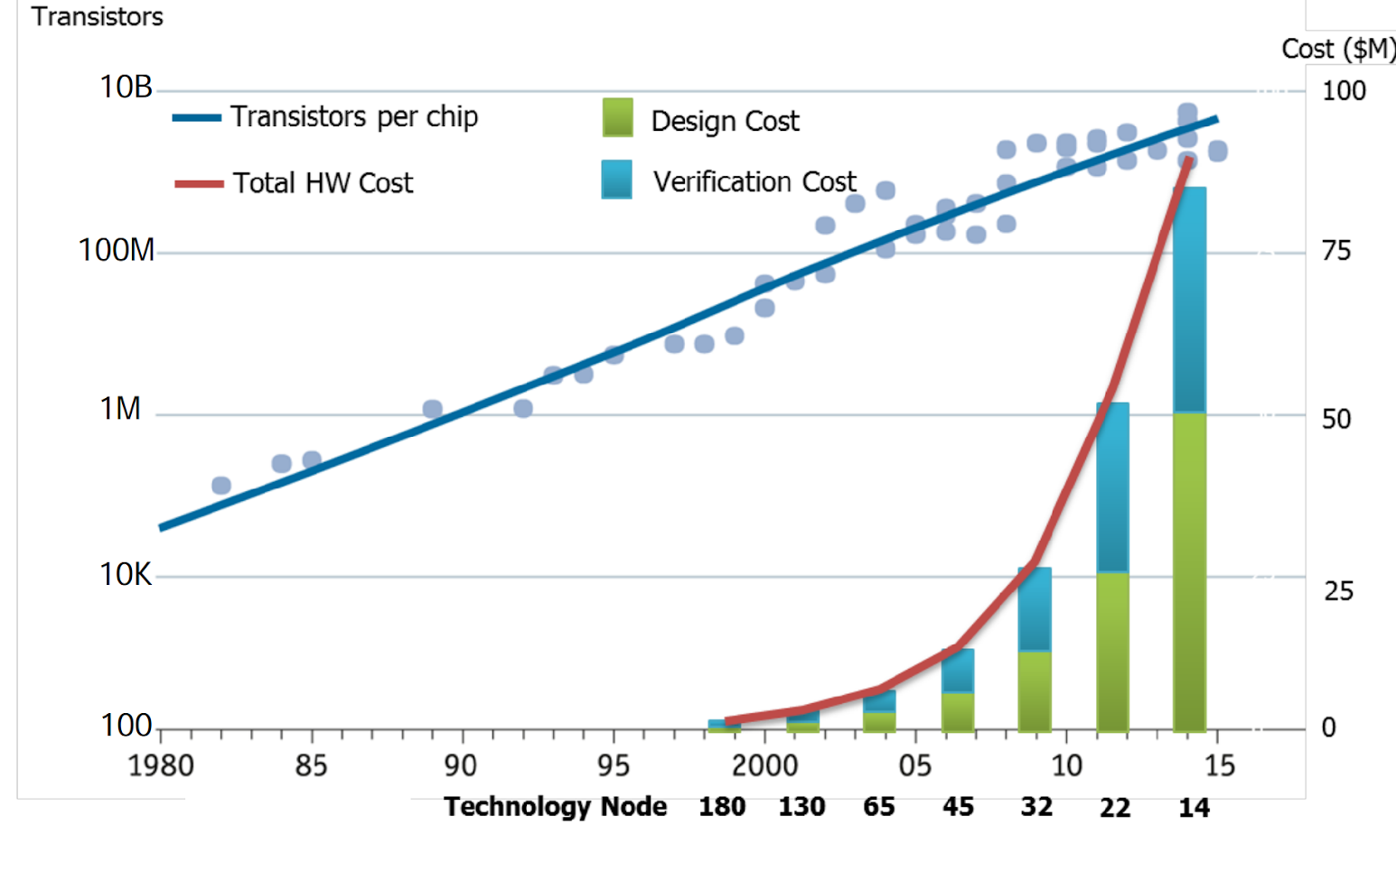
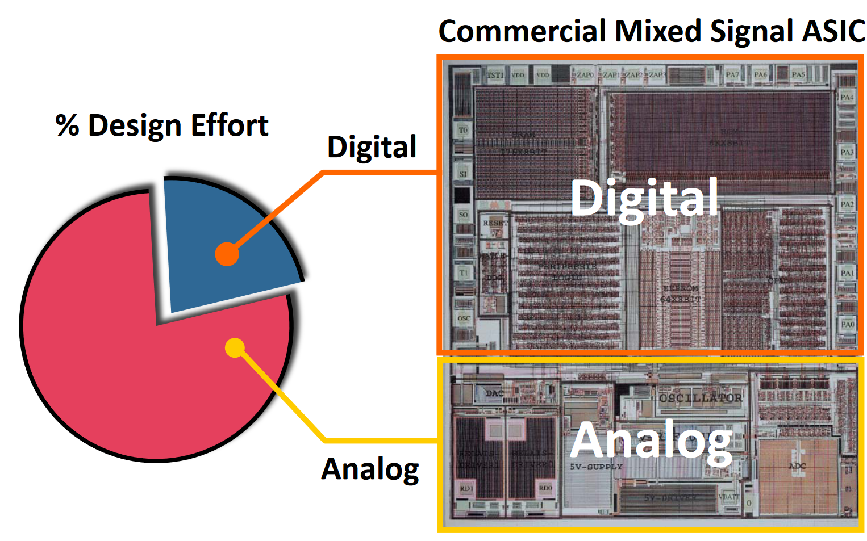
The Analog and Mixed-Signal Design Problem
Analog layout design is still heavily manual!
Sensitive to layout implementation
[Olofsson, 2018]
[Rutenbar, 2010]
Notes:
However, to support large scale adoption of the new circuit paradigms, we need to handle the design costs.
With the design size keep growing, the cost to design a chip is rapidly increasing.
To resolve this issue, EDA plays a key roles to make the design flow efficient.
It enables the semiconductor industry to design the modern chip, such as Apple M1 with 16 billion transistors and the recent wafer-scale engine with 2.6 trillion transistors.
However, the automated digital design flow does not apply to analog domain.
Up to today, most industrial analog designs are still done by human.
The lack of design automation has made analog design a bottleneck in the modern industry design cycle.
In layout design part, it is often that the layout designers are need to draw transistors one by one.
This practice make analog design error-prone and low efficient.
If we can automate the analog cycle, we can accelerate the design cycle and reduce manpower.
In my PhD research, I attempt to provide a solution to automate the layout design for analog circuits.

Slide 4
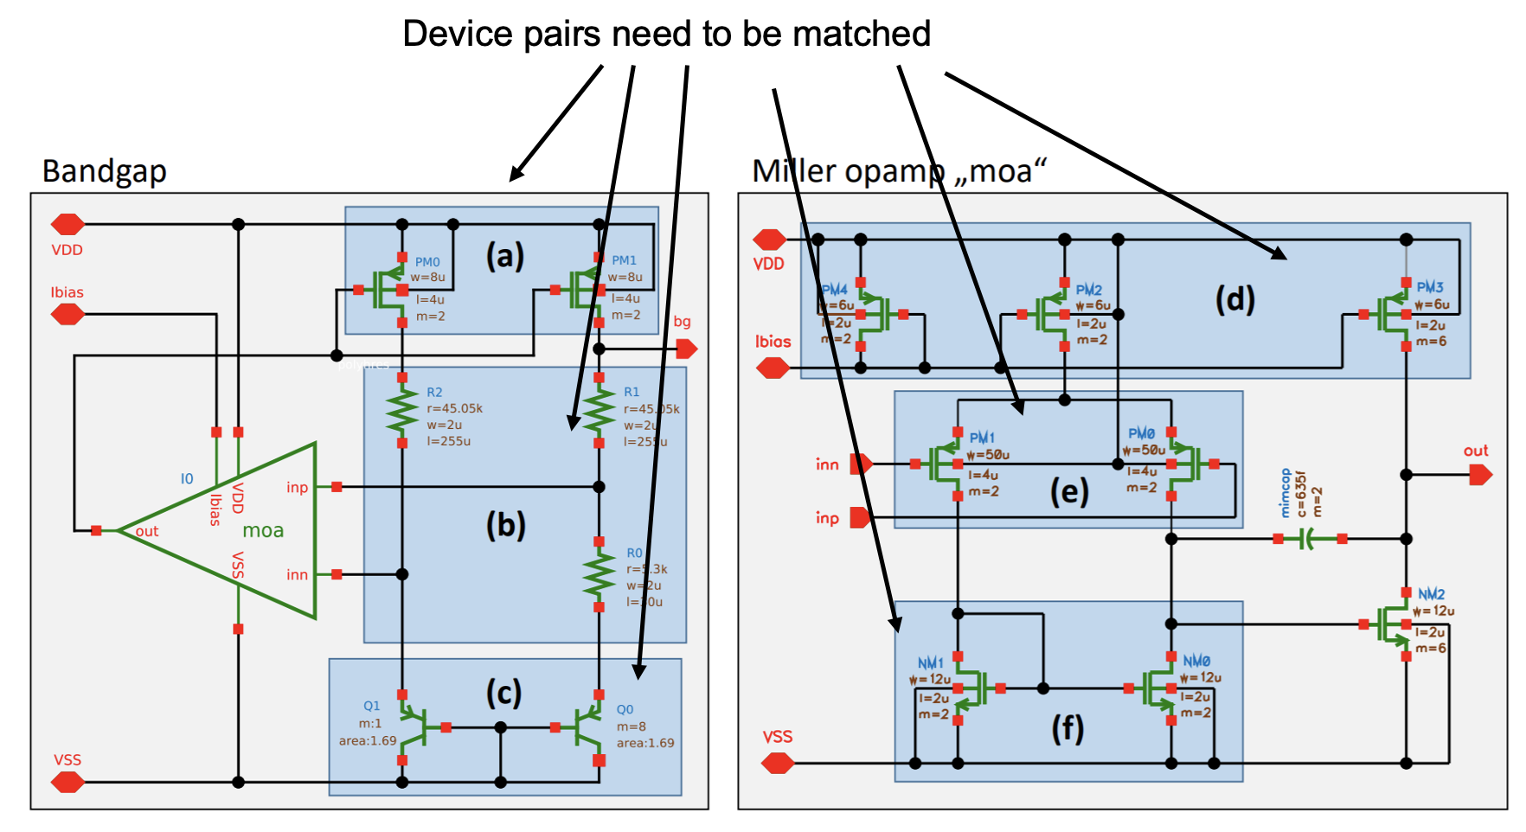
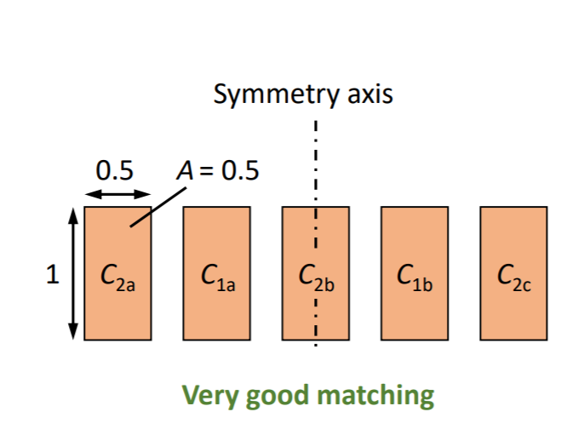
Background: Constraint and Parameters
Matching is crucial in layout implementation
Notes:
Before we going into the learning. Let’s have a few background on the layout constraints and parameters.
This page shows the most important layout constraint, matching.
The matching between devices, the device groups are critical in AMS circuit design.
To make sure the matched groups are having similar electrical characteristics, they need to be placed in matching patterns in the layouts, including symmetry, common centroid, interdigitation and so on.
This page shows some examples of matched devices in a schematic and some examples of how to match devices in placement.

Slide 5
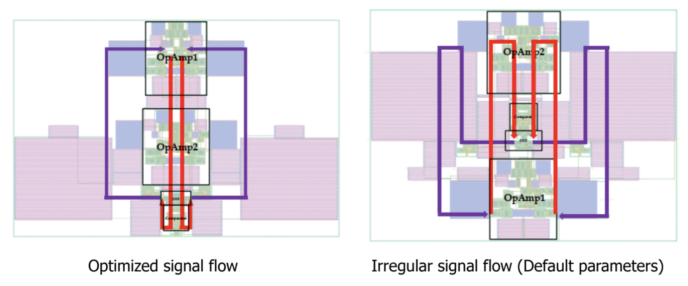
Background: Constraints and Parameters
Matching is crucial in layout implementation
Also needs:
Critical signals
Net wirelength
…
How to automate constraint setting?
[Liu+, 2020]
Notes:
Other than the matching, another typical thing is deciding the signal paths.
For example, as we introduced earlier today, the regularity of signal flows is critical to circuit performance.
In the early cases, they are either regarded as human specified inputs or we just to trail-and-error to find a good setting of net weights.
How can we automate these processes?

Slide 6
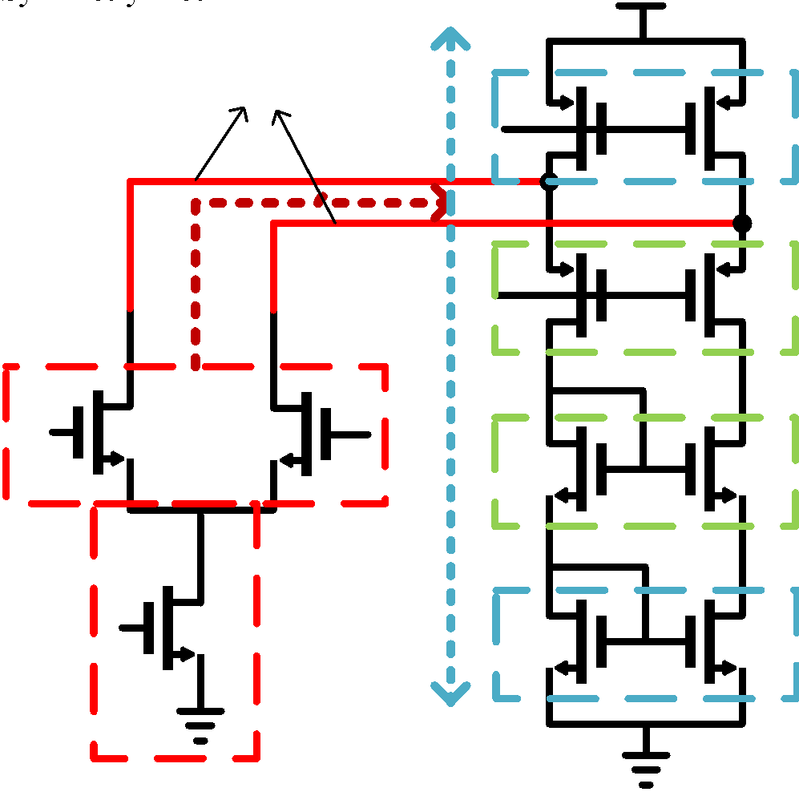
Background: Constraint Extraction
Symmetry nets
Conventional approaches
Pattern matching
Signal flow analysis
Graph isomorphism
Issue: Scale
Building block symmetry
[Xu+, 2019]
Notes:
There have been some research going on for extracting symmetry or matching constraints.
In conventional approach, people propose a set of heuristics to identify matching patterns.
They usually codes the criterion and inspect the netlist topology to assign the constraints.
This approach is hard to scale.
Some other method use graph isomorphism as the criterion.
This approach is limited by the graph size and is inflexible because it is very difficult to be adjusted and cannot learn from data.

Slide 7
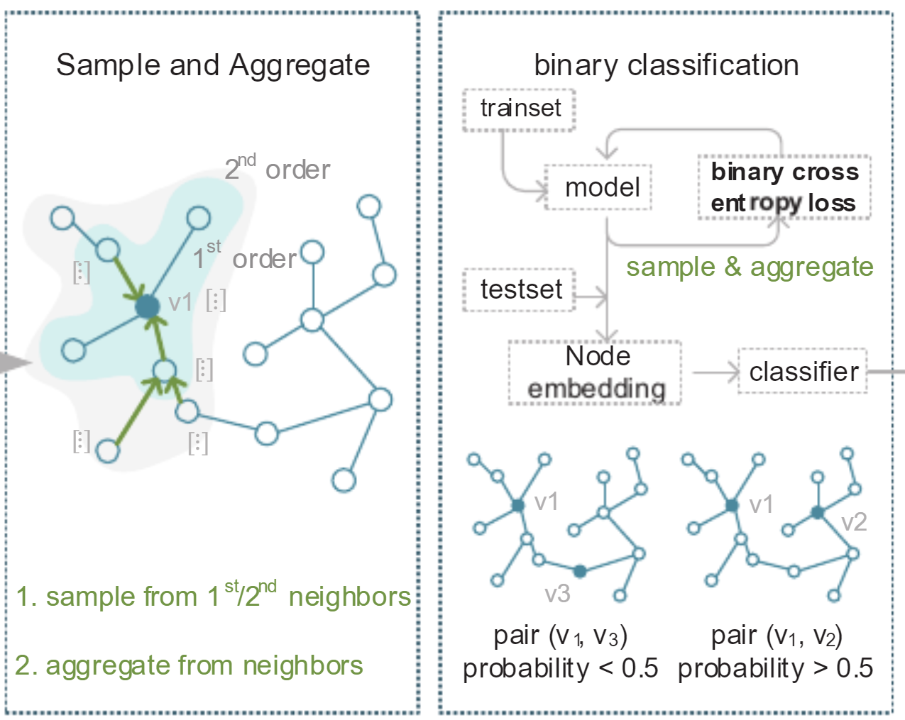
Background: Constraint Extraction
Conventional approaches
Pattern matching
Signal flow analysis
Graph isomorphism
Recent trends using GNN
Supervised learning
Graph similarity
Issue: Scale
Issue:
Label/Generality
[Gao+, 2021]
Notes:
The recent trend is to use graph neural network to identify the symmetry constraints.
The plus is it enable the symmetry extractor to directly learn from data.
This enable the automation tool to get higher accuracy and can scale easily.
The machine learning approach free the software designer from coding the heuristics and allow the pattern recognition process to be automatic.

Slide 8
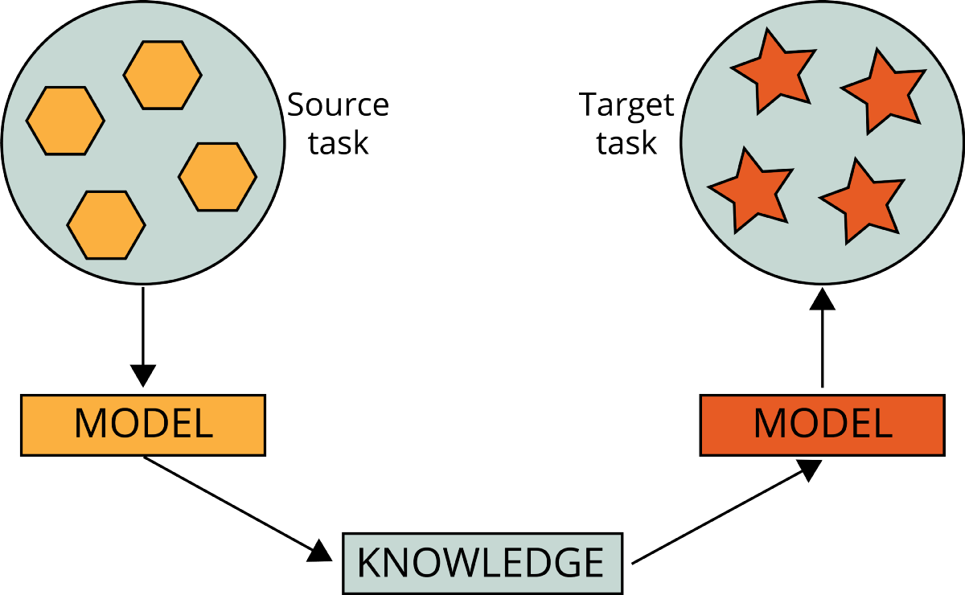
Challenges in Automatic Constraint Extraction
Specifically designed algorithm
Hard to transfer other constraint types
Supervised learning
Fewer labels for other constraints
Difficult to learn circuits
Our approach: pre-trained representation model + TAG architecture
→ Data Efficiency
→ Model Expressivity
Notes:
However, there are still a few drawbacks of the current methods.
The first challenge is how to extend the symmetry detection to other constraints and parameters.
The existing methods are mostly solely working for symmetry detection and very few of them tries on other constraints.
One reason is that symmetry is closely related to the isomorphism in topology so to some degree, it is relatively easy compared to some other constraints.
Another major reason is the data.
Unlike matching which is very common in AMS circuit design, other constraints either are fewer or hard to quantify.
Our idea to solve this challenge is to leverage the transfer learning and the idea of pre-trained representation learning.
We propose to train a representation model for analog circuits using a large-scale design database.
Then we transfer the pre-trained model for other downstream tasks.
This methodology can help improving the data efficiency and enable few-shot learning for other constrain types.

Slide 9
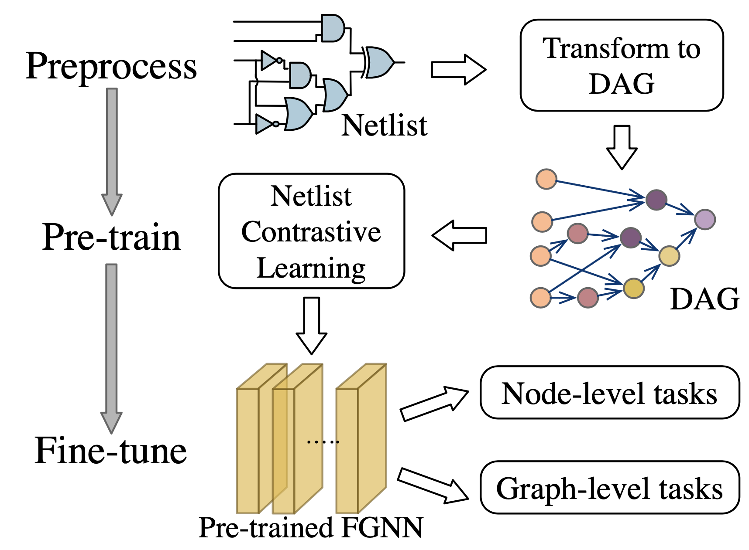
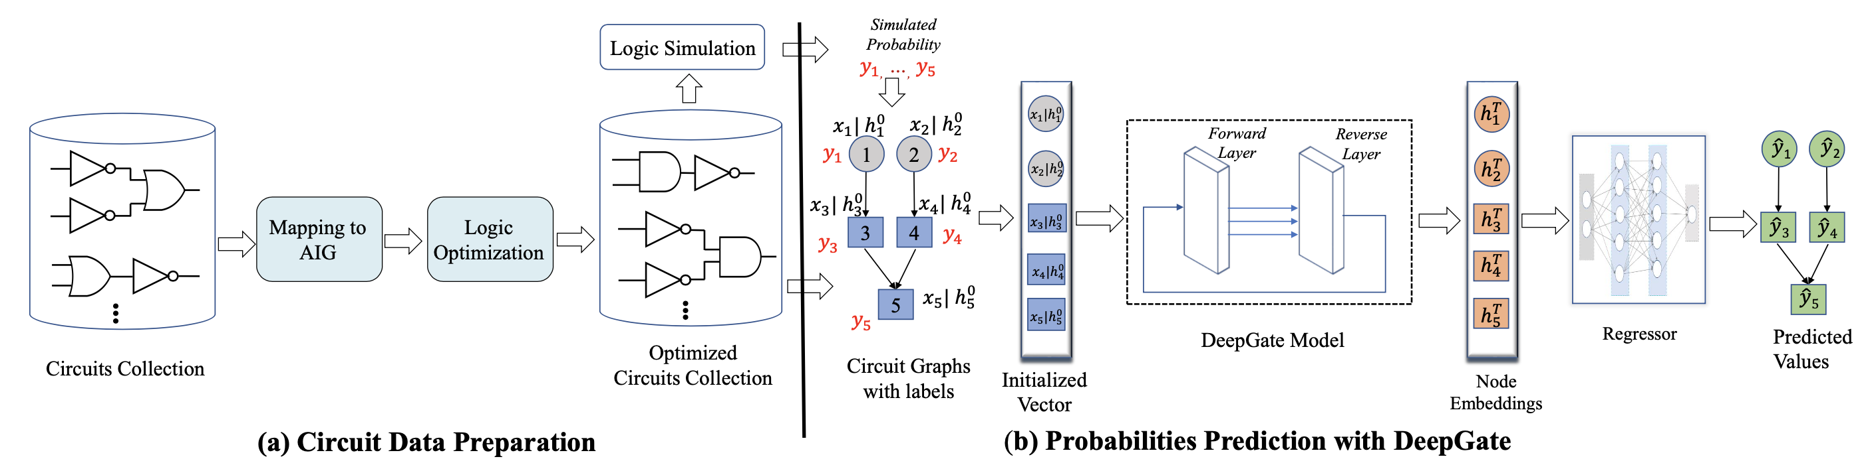
A Broader View: Generalized Circuit Learning
Contrastive learning to learn netlist functionality [Wang+, DAC22]
To learn AIG graph output distribution [Li+, DAC22]

Slide 10
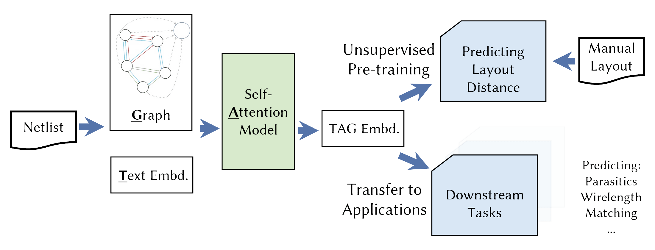
Method: TAG Pre-trained Model
Pre-train the representation with human layout data
Unsupervised pre-train with placement distance
Transfer pre-trained embedding to other tasks
Novel network model: Text, Self-Attention and GNN
Data Efficiency
Expressivity
Notes:
This page show the overall picture of this work.
On the methodology side, we propose to pre-train a circuit representation model with unsupervised learning.
In the pre-training, we let the model predict the placement distance of instances in manual layouts to let the model learns valuable knowledge for the AMS circuits.
Then we can transfer the learned knowledge to other downstream tasks.
On the algorithm side, we propose the TAG model.
It introduces the natural language texts in circuit representation and the self-attention layers into the network architecture.
Together with the graph neural network, our proposed model can largely improve the capability of neural network on capturing the circuit architecture.

Slide 11
Unsupervised Placement Distance Prediction
Pre-train to predict instance placement distances
Synopsys StarRC to extract instance layout locations
The proximity in placement implies signal flow, critical nets, matching, etc.
TAG
Circuit
Netlists
Prediction
Analog
Design
StarRC
Manual
Layouts
Golden
Notes:
Let’s first talk about the methodology.
We choose the placement distance as the pre-training prediction target.
It is closely related to the proximity that is a result of manual layout design expertise.
We use an industrial extraction tool StarRC to extract the device position from manual layouts.
Our training data are from an industrial design database from Nvidia.
It contains many mixed-signal designs in TSMC 5nm technology.

Slide 12
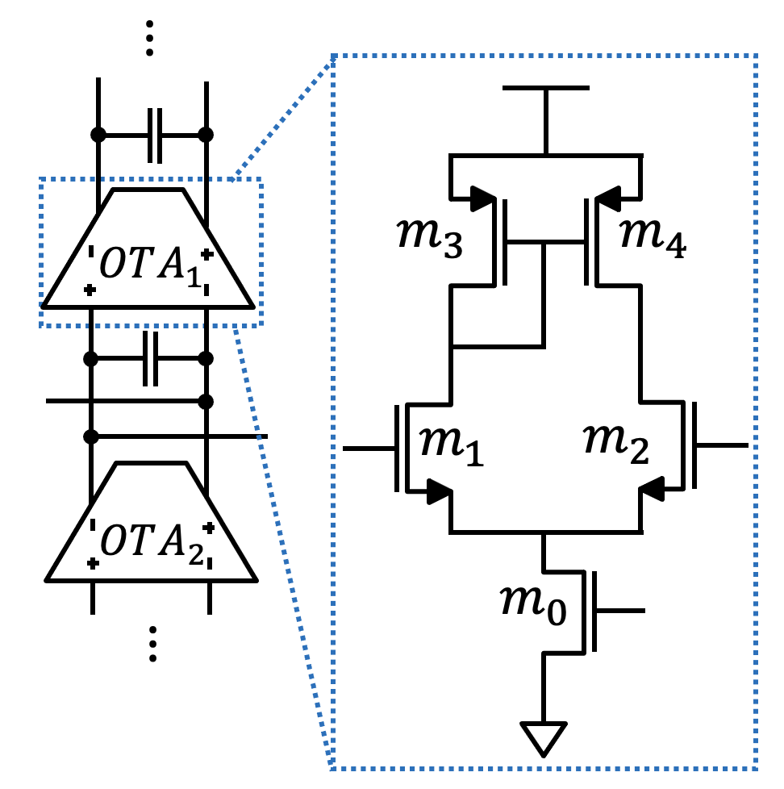
Normalized Placement Distance
AMS circuit designs are naturally hierarchical
CAD algorithms cares more on the same hierarchy level
Solution: focus on the same hierarchy level → Normalize
Predicting the samples at the same sub-circuit
Notes:
However, it turns out predicting the absolute distance in placement is not what we need.
AMS circuits mostly are hierarchical designs.
That means the building blocks can be recused across different top designs.
And the typical design philosophy is to build the system hierarchically and in bottom-up direction.
Take the figure here as an example, the left system design has a series of OTAs.
However, instead of generating the two OTAs in a flatten netlists, people would first design an OTA and reuse it in a higher hierarchy.
To fit this manner, we would like our model can work on any hierarchy level.
So instead of predicting distance in the flatten layout, we will focus on each level and predict the normalized distances.

Slide 13
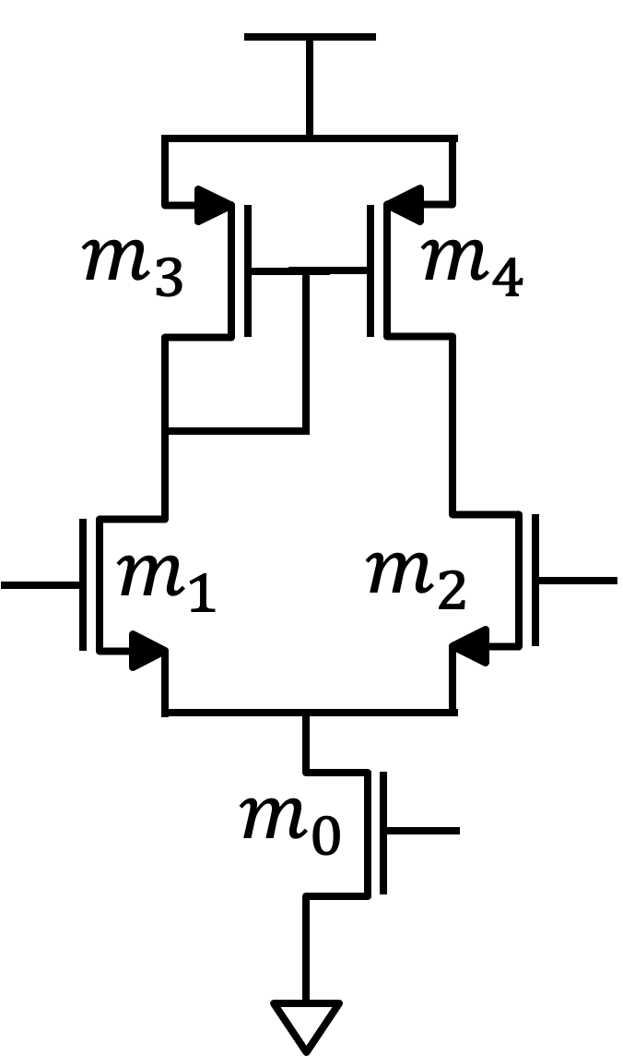
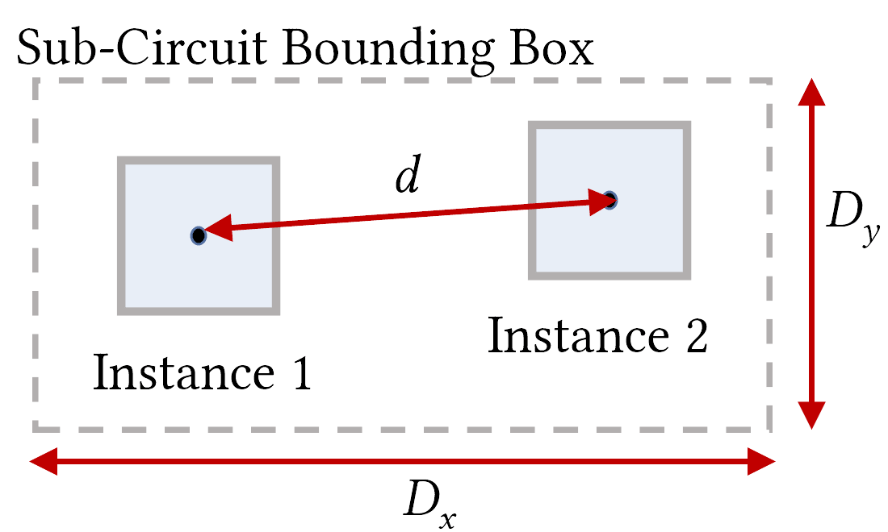
Normalized Placement Distance
Predicting relative placement distance
Pick samples from the same sub-circuit level
Normalize the distance with the bounding box
Allow the learned knowledge to be inductive
Notes:
Here shows our prediction target.
We call it relative placement distance.
For a sub-circuit, which can be the leaf or at a higher level, we predict the relative distance of its instance pairs.
For each pair, we take its distance and normalize it with respect to the sub-circuit bounding box in the layout.
The trained model then can apply to any hierarchy level as the knowledge it learned is homogenous and inductive to different hierarchy levels.

Slide 14
TAG Model Architecture
TAG model is designed for circuit learning
Text embd: incorporate human design expertise
Self-attention: share global information
Graph: model circuit topology
Notes:
After we define the training target, let’s discuss on the algorithms.
As the name suggests, the TAG model is mainly consisted of three elements: text embeddings, self-attention layer, and graph neural network.
The output of the TAG model will be the representation embedding for each circuit instance, including devices and sub-circuits.
These embeddings can then be feed to downstream networks or other heads for different tasks.
We will then present the components.

Slide 15
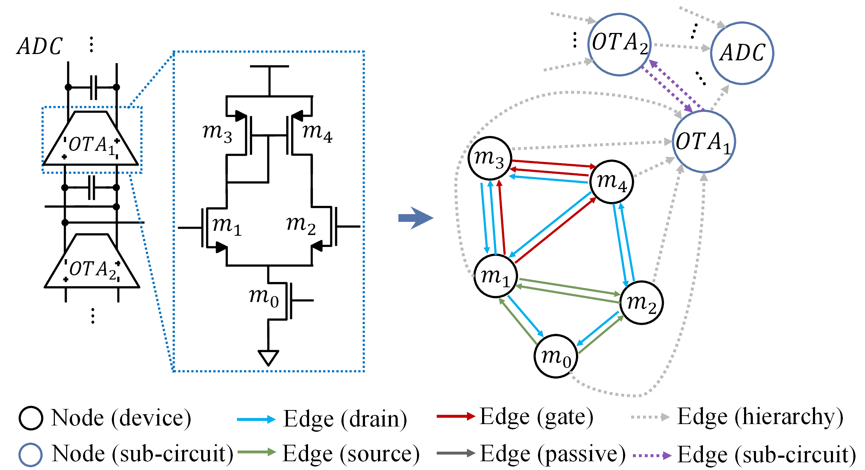
Graph: Graph Representation and GNN Model
Hierarchical graph representation of circuit topology
Heterogenous graph with multiple edge types
GNN networks are applied to the graphs
Notes:
The graph model we use to represent the circuit topology is a hierarchical and heterogenous graph.
The figure here shows an example.
Suppose we have an ADC circuit consisting two OTAs.
Each circuit will first has its own circuit node. For example, the OTA1, OTA2 and ADC nodes on the right.
The circuit node is connected to its children nodes.
In the OTA1 example here, there are edges connecting it with the five transistor nodes.
The topology of the five transistor nodes are connected with edges to represent their connectivity.
Each edge is associated with a edge type to distinguish the pin types such as gate, drain and etc.
The higher-level connectivity is also represented with the edges.
The graph representation is homogenous for different hierarchy levels which allow us to use the same machine learning model for different levels.

Slide 16
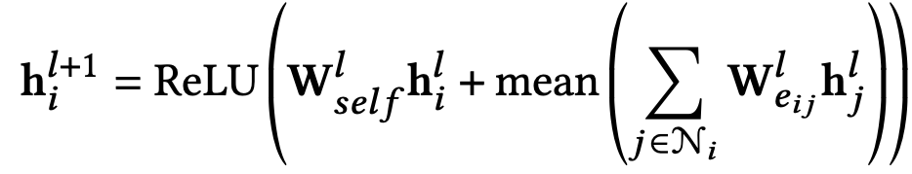
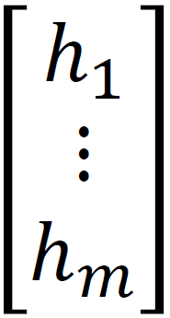
Graph: GNN Network
TAG model uses two types of GNN layers
1: Edge type-aware convolutional layer
Different weight matrices for different edge types
Notes:
We use two types of graph convolution layers on the graph.
The first is a edge-type aware convolutional layer.
The equation here shows its computation.
Explain Weij – trainable hj neighbors.
By giving different weights for different edge types. We allow the model to distinguish different pins.

Slide 17
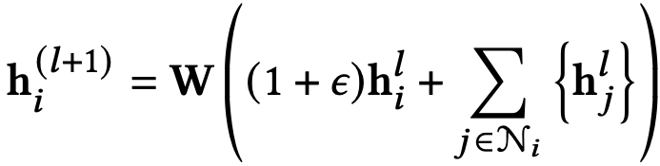
Graph: GNN Network
TAG model uses two types of GNN layers
1: Edge type-aware convolutional layer
2: GIN [Xu+, 2019]
Powerful ConvGNN to learn graph topology
Notes:
Another type of layer type is the popular GIN network.
It is a powerful GNN variant for better capture the graph topology information.
In our experiments, we empirically select the GNN layers and we found the GNN architectures has relatively minor impact on the final performance.

Slide 18
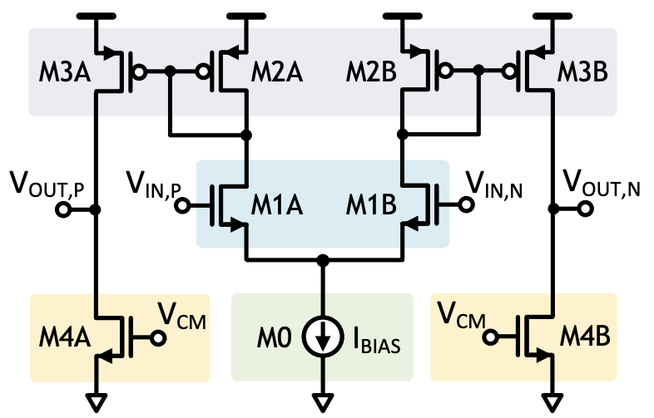
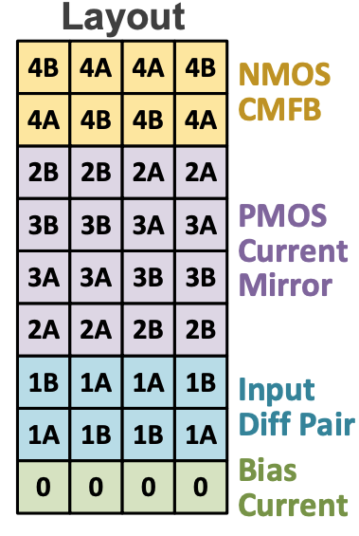
Text: Naming in Netlists
Naming implies considerable knowledge
Circuit/device name: suggest the functionality
Hierarchy name: suggest division in hierarchy
Instance name: suggest functionality and proximity
Notes:
Another innovation of our model is the introduction of text information in the machine learning prediction.
The circuit netlists are in fact containing significant amount of natural language.
They incorporate substantial knowledge about the circuit functionality.
The circuit and device names indicate the functionality of an instance.
The hierarchy name make an emphasis on the system structures of the circuits.
Even the instance names take knowledge.
In the figure here, we can see that the symmetric structures are encoded in the instance names and those names are related to the layout placements.
Although there exists the cases that the naming is arbitrary, our experiments suggest they are less important and overall leveraging the natural language can greatly helps the machine learning models to make prediction.
In TAG, we encode those texts into vectors that serve as learning features.

Slide 19
Text: Encoding Natural Language Into Vectors
Natural language corpus for word embedding training
Collect sentences from netlists
Combine with English Wikipedia corpus
Unsupervised learning to discover the meaning of words
fastText algorithm [Bojanowski+, 2016]
<Ckt Name> <Dev Name 1> <Dev Name 2> <Dev Name 3>…
<Inst Name> <Dev Name> <Net Name 1> <Net Name 2>…
…
Notes:
We use a pre-trained word embedding model to encode the texts.
It is trained on a circuit corpus in a unsupervised training scheme.
To make the word embedding model more effective, we create a language corpus that containing circuit knowledge.
We obtain a large set of circuit netlists and extracts many sentence from them.
Those sentence are not standard English but a sets of netlist naming.
We treat the name of a circuit and its leaf devices into a sentence.
We generate a sentence for each instance with its instance name, device type and the names of nets connecting it.
With the large amount of the data, the word embedding model can learn the meaning of each word in a probabilistic setting.
The circuit corpus is combined with standard English natural language corpus to increase the data size further.

Slide 20
Text: Encoding Natural Language Into Vectors
Adopt fastText algorithm [Bojanowski+, 2016]
Unsupervised training with corpus
Use hashed dictionary to handle unseen words
Learn from sub-word knowledge
mang
ange
erai
man
ang
gera
era
mangerai
nge
ger
rai
nger
Character n-grams
Word itself
[Bojanowski, 2016]
Notes:
The word embedding is using the fastText algorithm.
Compared to more conventional word2vec model, two major advantages of this algorithm are: first it can be used for unseen word, second it can explore subword information.
These two advantages are important in our application.
With the ability to generate embedding for unseen words, we can use the model for new circuit.
The subword is also important in circuit learning.
As we saw in the examples before, the naming of an instance or circuit type has many conventions.
Those convention, such as underscore bias, M1A and M1B, are actually encoded into the subwords.
The fastText model allows us to efficient exploit those knowledge.
Due to the limit of time, we will not go into the details of how fastText is trained.

Slide 21
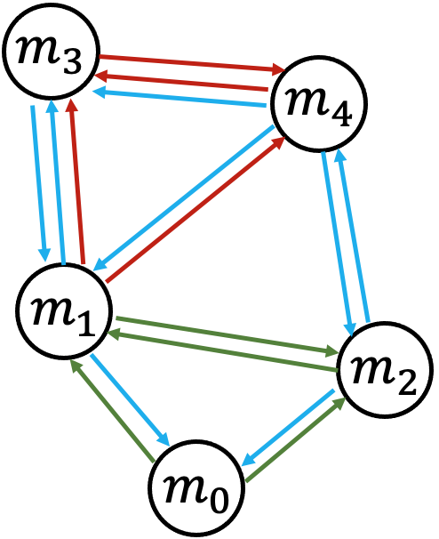
Self-Attention: Aggregate Information In A Circuit
GNN works on convoluting local knowledge
Limited receptive field
Over-smoothing issues
How to give nodes the global view of the sub-circuit?
Notes:
Another innovation in TAG model is the addition of self-attention layers.
The GNN alone has difficulty of capture the global information and its learned knowledge are concentrated within a small range of hoops.
The self-attention mechanism provide a solution to it.

Slide 22
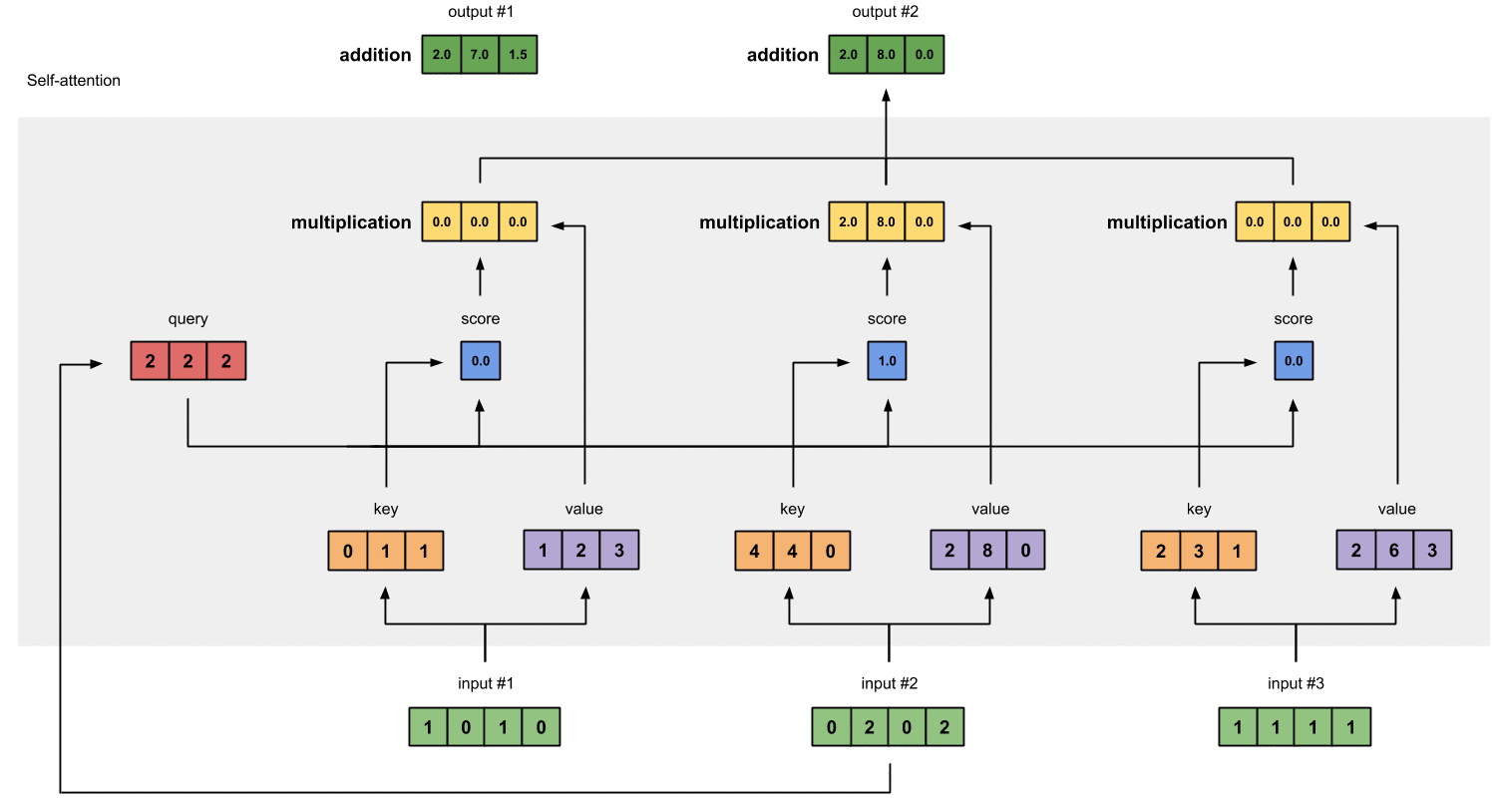
Self-Attention: Aggregate Information In A Circuit
Self-attention layer share the information between elements in a sequence
Notes:
Self-attention layers have been adopted to many problems.
But the most famous one is its application in natural language processing.
Some of you may heard of the famous transformer models.
The transformer is mainly relying on the self-attention layers.
Self-attention mechanism is related more complex than the typical fully-connected layer, CNN and etc.
The key idea is that it works on a sequence of data.
A linear transformation will be firstly applied to one element to generate three supporting vectors, the key, query and value.
Then each element in the sequence will use the keys and queries to decide the attention or the scores of the other elements.
The scores then serve as weights in aggregation the information.
We will not go into the details. But the basic idea is that, the self-attention layer can apply to arbitrary length of sequence.
It allows the information of the elements in the sequence to be exchanged with each other.
The performance is maintained by using the attention to capture the important messages, in contrast of applying mean aggregation to smooth everything.
This behavior is exactly what we need in sharing global view in a circuit.

Slide 23
Self-Attention: Aggregate Information In A Circuit
Node embeddings in a sub-circuit are correlated with SA
m₀
z₀
SA
m₁
z₁
m₂
z₂
m₃
z₃
m₄
z₄
Notes:
In TAG, we apply self-attention layers to each sub-circuit to make the output embedding capturing global information.
In this example, the five transistors nodes first went through a GNN to get the initial node emebddings.
However, due to the limit of GNN architecture, M4 and M0, for example, are far away from each other and might not aware of the other’s information.
Here we apply the self attention layer on the five node embeddings.
And then the neural network can potential capture the relation between M0 and M4, and producing a set of output embedding that contains more global knowledge.

Slide 24
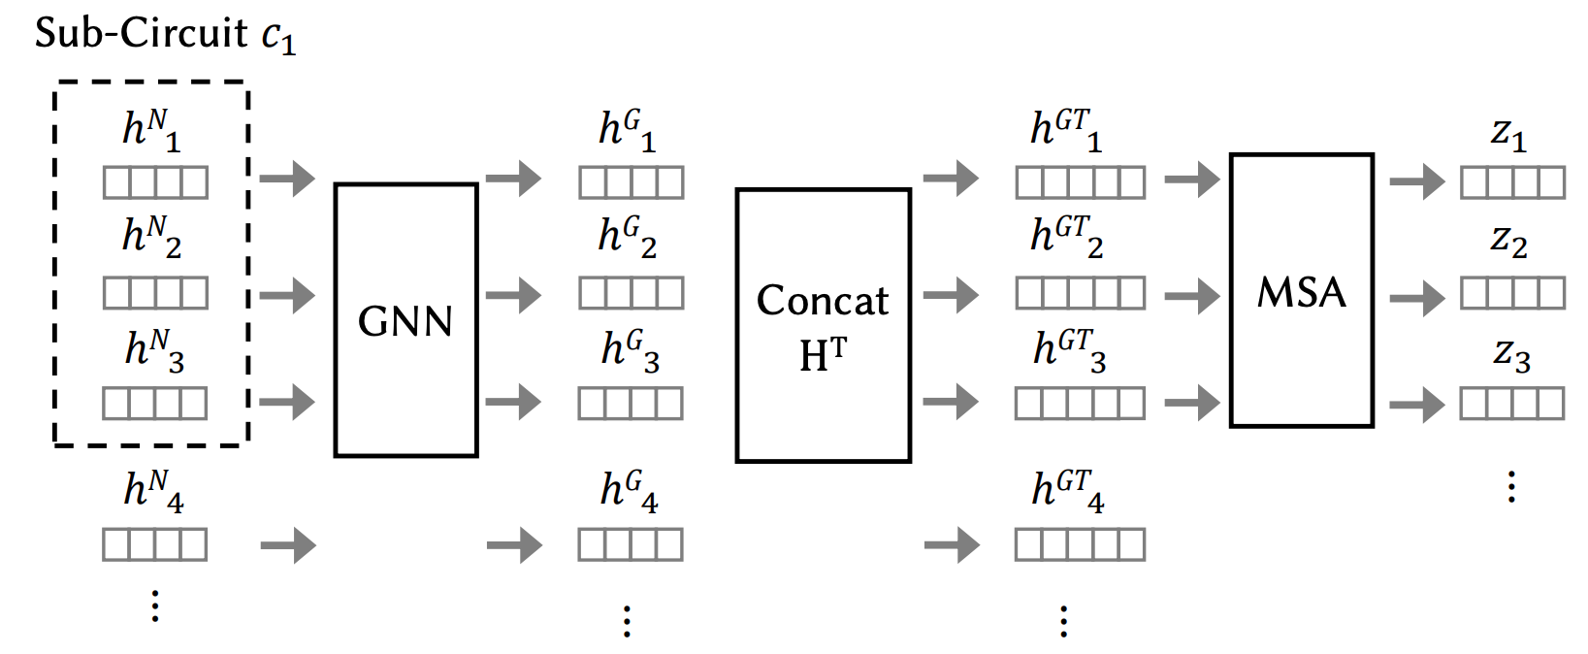
TAG: Complete Model Architecture
Add text encodings
Multi-head SA
Device features
GNN embds
TAG embds
Notes:
Now we can put the TAG embedding model together.
The initial feature vectors are sent to GNN.
Then it is concatenated with the text embeddings from fastText models.
The resulting embeddings within the same sub-circuit and hierarchy level are extracted and sent through a self-attention layer which produce the final TAG embeddings.
The TAG embeddings can then used for other heads for different prediction tasks.

Slide 25
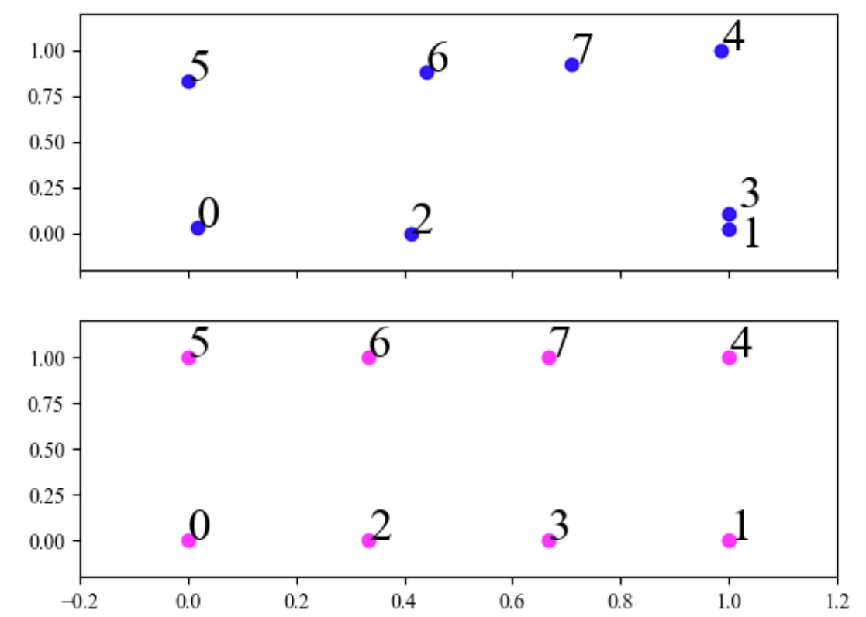
Experimental Results: Pre-Training
Accuracy on predicting relative placement distance
PCA of TAG embds
 | R² | MAE | sMAPE
DAC’21 | 0.068 | 0.191 | 0.502
GNN Only | 0.075 | 0.134 | 0.502
Text Only | 0.194 | 0.187 | 0.489
TAG | 0.640 | 0.122 | 0.364
Real
Layout
Pos
Notes:
Mean absolute error
Symmetric mean absolute percentage error
Let’s take a look on the experimental results.
This page shows the results of TAG model on the pre-training target.
%The above is the PCA plot of the TAG embeddings of eight transistors.
%We can see that they are closely related to the real placement positions.
%This is expected considering how to configure our custom loss function.
%The left shows an example of TAG embedding space versus real placement.
The table on the right shows the accuracy of predicting relative placement distances.
The R^2 scores are the higher the better.
The mean absolute error and symmetric mean absolute percentage error are the lower the better.
The TAG model has clear advantages over the other methods in the metrics.
Next, we will provide a few applications of the pre-trained TAG model to other tasks.

Slide 26
Case Study 1: Predicting Layout Matching
Accuracy on predicting whether two instances are matched in manual layouts
 | ACC | TPR | FPR | PPV | F₁
DAC’21 | 0.805 | 0.724 | 0.086 | 0.919 | 0.810
GNN Only | 0.731 | 0.706 | 0.246 | 0.730 | 0.718
TAG from Scratch | 0.730 | 0.666 | 0.208 | 0.751 | 0.706
TAG Pre-trained | 0.833 | 0.915 | 0.244 | 0.780 | 0.842
Notes:
accuracy (ACC), true positive rate (TPR), false positive rate (FPR), positive predictive value (PPV), and 𝐹1-score
The first case study is for predicting the layout matching.
We take the pre-trained TAG embedding to a simple FC network and let it predict whether two instances are matched in manual layouts.
We can see that the proposed method can overall beat DAC’21, which is a dedicated matching prediction algorithm.
This shows our generalized circuit learning paradigm can easily achieve state-of-the-art performance in other tasks.

Slide 27
Case Study 2: Predicting Wirelength
Accuracy on predicting the normalized wirelength of a net
 | R² | MAE | sMAPE
DAC’21 | 0.203 | 0.198 | 0.520
GNN Only | 0.027 | 0.219 | 0.566
TAG from Scratch | 0.153 | 0.212 | 0.543
TAG Pre-trained | 0.570 | 0.139 | 0.469
Notes:
Mean absolute error
Symmetric mean absolute percentage error
The second case study is on predicting the net wirelength normalized with the circuit bounding box.
Similar to the pre-training target, the TAG model clearly outperform other methods.
The prediction of wirelength can potentially helps the layout automation on deciding the floorplan.

Slide 28
Case Study 3: Predicting Parasitics
Accuracy on predicting the post-layout net capacitance
 | 0.5fF | 1fF | 10fF | 100fF | 1pF
DAC’20 | 0.495 | 0.830 | 0.854 | 0.872 | 0.308
TAG Pre-trained | 0.678 | 0.876 | 0.856 | 0.870 | 0.411
 | Mean | Geometric Mean
DAC’20 | 18.6% | 4.97%
TAG Pre-trained | 11.8% | 4.17%
R² in predicting net capacitance
Error in simulated performance
Notes:
Mean absolute error
Symmetric mean absolute percentage error
The last application is on parasitic prediction.
Predicting post-layout parasitics from pre-layout schematic becomes important in advance technology, because the pre-layout simulation can have error on average of more than 30% compared to post-layout.
In this case study, we augment the state-of-art parasitic model with TAG embeddings as additional features.
In the experimental results, we found that the TAG model can noticeably reduce the error in predicting parasitic and leads to a much smaller error in simulated performance.
The three case studies show our proposed paradigm can be beneficial for a lot of applications.

Slide 29
Conclusion
A new methodology of pre-trained circuit representation learning
Use manual placement distances as training targets
Transfer to other downstream tasks
A novel network architecture highlight “TAG”
Text, Self-Attention and Graph
Experimental results show transferability
Three case studies of downstream tasks
An early step towards general circuit learning
Notes:
Today, we present four research projects I’ve done in my PhD in the goal of practical fully-automated AMS layout synthesis.
First, I propose a new machine learning-guided analog router.
It unveil a new paradigm of using machine learning to replace the manual featuring engineering on create the constraints.
Then, I develop a system signal flow-aware mixed signal placer.
I believe it is breakthrough of automated AMS placement algorithm by moving from simple analog blocks to real-world mixed signal systems.
Third, I propose a novel well-aware analog placement framework.
It provide a new methodology to handle the well generation problem by integrating the machine learning guided well generation and analog placement together.
In the end, I present our recent work on analog representation learning.
With the novel pre-training methodology and neural network architecture, the proposed framework show strong applications in three case studies.
It is a generalized circuit learning framework that can potentially boost the future research of automated layout constraint extraction.

Slide 30

Thanks Q&A
Notes:
This conclude my presentation. Thank you. I would be more than happy to take any question.

Slide 31
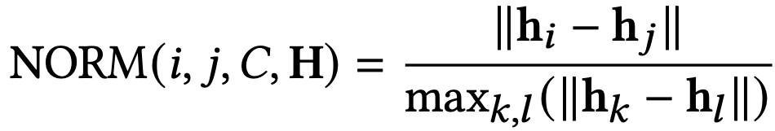
Pre-Training To Predict Relative Distance
Custom distance prediction loss
Directly constraint embedding space to correlate with layout distance
Measure layout distance with embedding space distance
Add normalization and fully-connected layers for performance
Notes:
Here we show the unsupervised pre-training head.
We use a custom distance prediction loss to pre-train our TAG model. It direct constraint the embedding space to correlate with the relative placement distance.
Look at the equation above, the hi and hj are the TAG embeddings of two instances. We divide their embedding distance with the perimeter of the sub-circuit in the embedding space.
Here the denominator is basically finding the longest distance of instance pairs in the embedding space.
This loss effectively map the embedding space h to the relative placement distance space.
In the real training, we add additional layer normalization and fully connected layers to the TAG embedding before calculating the loss, as the bottom equation shows.
It empirically improve the model transferability.

Slide 32
Backup
Notes:
This conclude my presentation. Thank you. I would be more than happy to take any question.

Slide 33
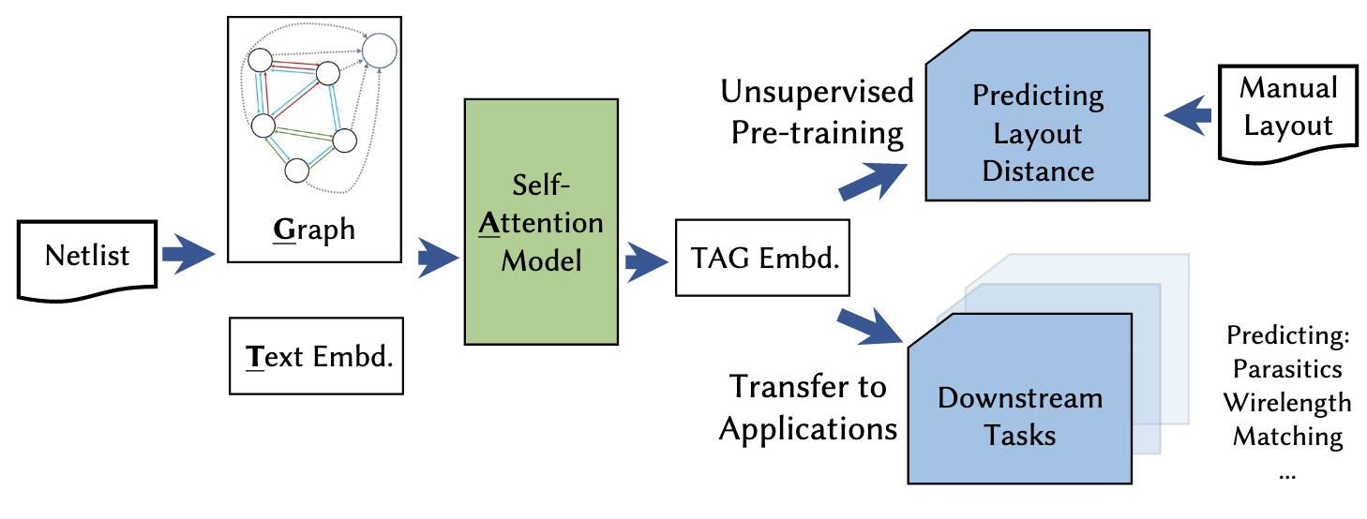
Analog Circuit Learning
Foundational research for future intelligent AMS layout system
Learn circuit representation using manual layout data
Transfer to various downstream applications
Automate constraint generation, parameter setting, etc.
Notes:
This work is more a foundational research for the future development of AMS layout automation and other AI-assisted IC design automation. It proposes a new paradigm of analog circuit representation learning with large scale circuit database as training set.
As we can see, IC design automation most time is dealing with circuits.
In layout automation, for example, how to adjust floorplan, assign signal path weights and etc. are decided by the circuit architecture, netlist topology and so on.
In analog flow, the circuit designer will look at a schematic design and decide how to design its layout.
To let the AI helps more on design automation, we definitely want the AI to understand the circuits and learn their design.
If an AI is capable of recognizing the critical patterns in schematic design, it can help deciding on the layout constraints and parameters.
However, circuit learning turns out to be hard. And not many research has been done in this direction.
In this work, we first propose a new methodology of training an analog circuit representation model using manual circuit design database.
And we propose a novel network architecture to enable effective circuit learning.
We transfer our pre-trained circuit representation in three downstream tasks to evaluate its power in the experiments.

Slide 34
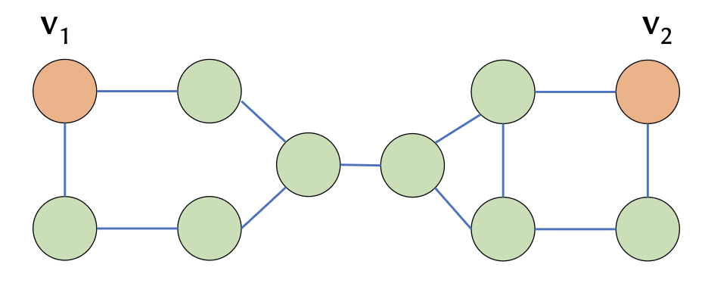
Challenges in GNN-Based Circuit Learning
Conventional GNN is
Hard to distinguish isomorphic local structure
Focus on local information
Our approach: word embedding and self-attention
Notes:
Another challenge is on the algorithm side.
Convolutional graph neural network is widely used nowadays for circuit-related learning tasks.
However, the current mainstream GNN architectures have a few fundamental limits.
GNN is relying on the graph convolution operation.
Take the left figure as an illustration.
Each node and sometimes each edge contains a vector of numbers.
The graph convolution operation on each node first fetch the node features of its neighbors.
Then it apply a nonlinear transformation on the node feature space to get a set of new feature vectors.
The feature vectors are then aggregated , such as being averaged, into one vector which is regarded as the output of this layer.
In this process, the high frequency information are tended to be depressed
And the resulting features are more focusing on local information.
These characteristics limit the capability of GNN to capture the global knowledge and the topology information of a circuit graph.
Another drawback of the GNN is that it cannot distinguish the local isomorphic structure.
Think of the right figure, where v1 and v2 have the similar neighbor structures.
They are actually seem identical in the view of a GNN.
Then it cause the issues in design automation.
Think of a circuits which an array of same building blocks, such as a bus.
The ML model will have trouble doing prediction on them as they looks identical.
There have been some attempts from the machine learning community to solve these issues.
But based on our experience and experiments, they are still far away from practice.
In this work, we propose a new network architecture, we call TAG to solve these issues.

Slide 35
Graph: GNN Network
TAG model uses two types of GNN layers
1: Edge type-aware convolutional layer
Different weight matrices for different edge types
Notes:
We use two types of graph convolution layers on the graph.
The first is a edge-type aware convolutional layer.
The equation here shows its computation.
Explain Weij – trainable hj neighbors.
By giving different weights for different edge types. We allow the model to distinguish different pins.

Slide 36
Graph: GNN Network
TAG model uses two types of GNN layers
1: Edge type-aware convolutional layer
2: Graph Isomorphism network [Xu+, 2019]
Powerful ConvGNN to learn graph topology
Notes:
Another type of layer type is the popular GIN network.
It is a powerful GNN variant for better capture the graph topology information.
In our experiments, we empirically select the GNN layers and we found the GNN architectures has relatively minor impact on the final performance.

Slide 37
Self-Attention: Aggregate Information In A Circuit
Self-attention layer share the information between elements in a sequence
Notes:
Self-attention layers have been adopted to many problems.
But the most famous one is its application in natural language processing.
Some of you may heard of the famous transformer models.
The transformer is mainly relying on the self-attention layers.
Self-attention mechanism is related more complex than the typical fully-connected layer, CNN and etc.
The key idea is that it works on a sequence of data.
A linear transformation will be firstly applied to one element to generate three supporting vectors, the key, query and value.
Then each element in the sequence will use the keys and queries to decide the attention or the scores of the other elements.
The scores then serve as weights in aggregation the information.
We will not go into the details. But the basic idea is that, the self-attention layer can apply to arbitrary length of sequence.
It allows the information of the elements in the sequence to be exchanged with each other.
The performance is maintained by using the attention to capture the important messages, in contrast of applying mean aggregation to smooth everything.
This behavior is exactly what we need in sharing global view in a circuit.

Slide 38
Text: Encoding Natural Language Into Vectors
Adopt fastText algorithm [Bojanowski+, 2016]
Unsupervised training with corpus
Use hashed dictionary to handle unseen words
Learn from sub-word knowledge
mang
ange
erai
man
ang
gera
era
mangerai
nge
ger
rai
nger
Character n-grams
Word itself
[Bojanowski, 2016]
Notes:
The word embedding is using the fastText algorithm.
Compared to more conventional word2vec model, two major advantages of this algorithm are: first it can be used for unseen word, second it can explore subword information.
These two advantages are important in our application.
With the ability to generate embedding for unseen words, we can use the model for new circuit.
The subword is also important in circuit learning.
As we saw in the examples before, the naming of an instance or circuit type has many conventions.
Those convention, such as underscore bias, M1A and M1B, are actually encoded into the subwords.
The fastText model allows us to efficient exploit those knowledge.
Due to the limit of time, we will not go into the details of how fastText is trained.

Slide 39
Pre-Training To Predict Relative Distance
Custom distance prediction loss
Directly constraint embedding space to correlate with layout distance
Measure layout distance with embedding space distance
Add normalization and fully-connected layers for performance
Notes:
Here we show the unsupervised pre-training head.
We use a custom distance prediction loss to pre-train our TAG model. It direct constraint the embedding space to correlate with the relative placement distance.
Look at the equation above, the hi and hj are the TAG embeddings of two instances. We divide their embedding distance with the perimeter of the sub-circuit in the embedding space.
Here the denominator is basically finding the longest distance of instance pairs in the embedding space.
This loss effectively map the embedding space h to the relative placement distance space.
In the real training, we add additional layer normalization and fully connected layers to the TAG embedding before calculating the loss, as the bottom equation shows.
It empirically improve the model transferability.

